Slide 1
Zero Shot Machine Learning with LLMs

Slide 2
Steps in Machine Learning for Text Analysis
Data collection
Data preparation (cleaning, normalization, vectorization, feature extraction)
Model selection
Training
Evaluation
Hyperparameter optimization
Prediction (Application)

Slide 3
Step 2: Text → Data
To use a machine learning model for text-analysis, your text has to be represented numerically
Classical Machine Learning:
Options for representing text numerically:
Word frequencies
TF-IDF scores
Word embeddings
Part-of-Speech tags
Named Entities
You decide how to represent your text numerically, before sending it to the model
Large Language Models
Text is processed by the model
Text is represented as embeddings
You (usually) do not represent your text numerically before sending it to the model

Slide 4
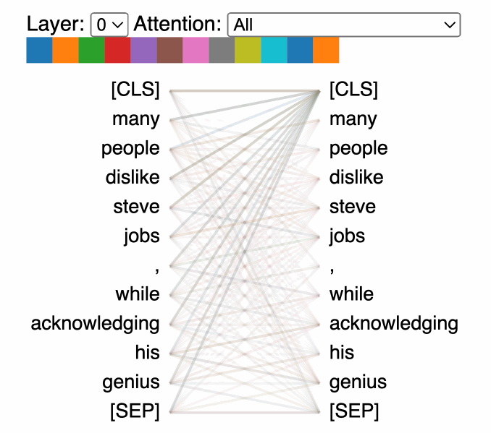
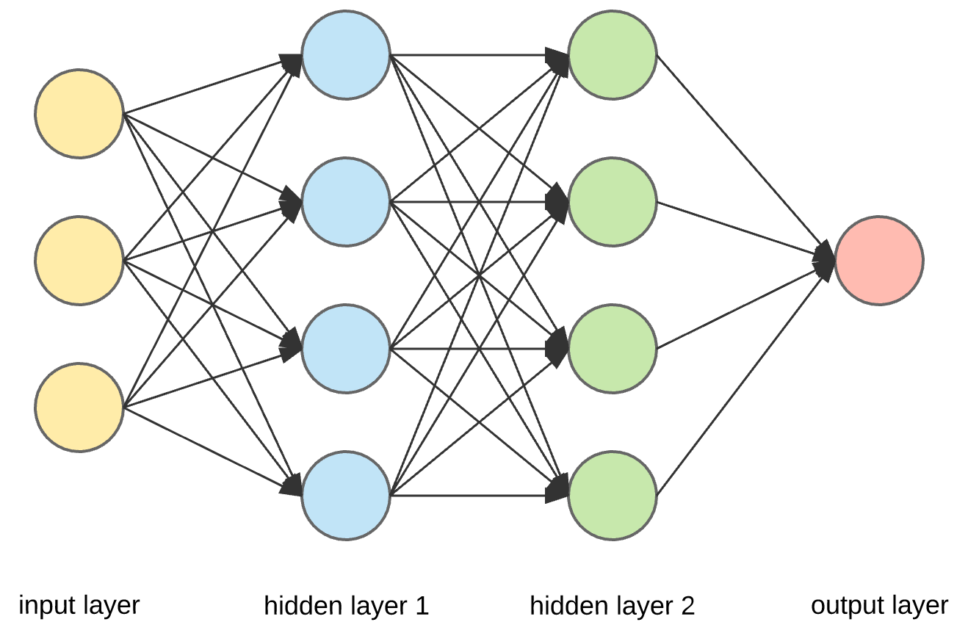
Large Language Models
Neural Network Architecture
Transformers (Attention!!)

Slide 5
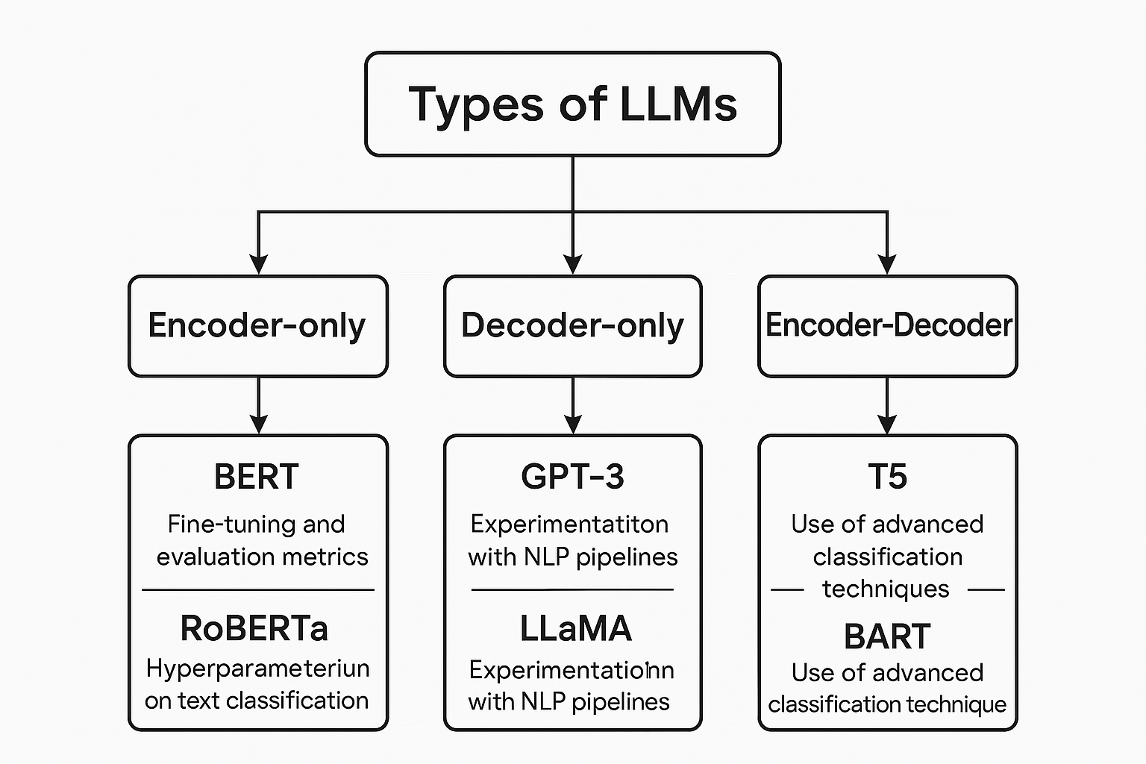

Slide 6
Classical Machine Learning for Text:
Examples:
Random Forest
Linear Regression
Naive Bayes
Support Vector Machines
Advantages:
Lightweight
Interpretable
Must represent text numerically in advance
Neural Network models for Text
Examples
Text generators (GPT)
Classifiers (BERT)
Translation/summarization (Marian, BART)
Advantages:
Accuracy!
Can pass text directly to the model

Slide 7

Hugging Face
Open-source repository for:
Pre-trained machine learning models
Datasets
Also features community forums
Maintains the python Transformers library
https://huggingface.co/

Slide 8
Zero Shot Learning
Type of transfer learning
Uses pre-trained LLM models
Training data NOT provided in advance

Slide 9
Steps in Zero-Shot Learning
Define your task (classification, translation, summarization etc.)
Select a model (usually from Huggingface.co!)
Prepare your data (Clean and organize text)
Load your model
Apply the model to your data
Save and analyze outputs!

